Slide 1



SocialApp
A Professional,
People-First MERN Stack Social Media Platform
Presented by:
Kesavan S
Spangles Infotech | 2025

Slide 2

List of contents
User Authentication & Profiles
Feed & Explore Modes
Express & Share (Posts)
Content Ownership & Security
Comments & Engagement
Real-Time Messaging
Build Your Community
Smart Notifications

Slide 3

Introduction
SocialApp is a modern social media platform built for real connections. Whether it's sharing moments, chatting in real time, or building your community, SocialApp makes it simple, secure, and enjoyable — all powered by the MERN stack.

Slide 4

Problem
Frontend
Backend
Managing real-time UI updates for messaging and notifications.
Ensuring mobile responsiveness and cross-device compatibility.
Handling image and video uploads with proper compression and preview.
Implementing efficient pagination, filtering, and lazy loading in feed.
Providing smooth UX for features like typing indicators, modals, and theme modes.
Structuring scalable APIs for posts, users, chats, and notifications.
Real-time communication using WebSockets (Socket.IO) with presence management.
Data consistency across modules (likes, followers, comments).
Handling media uploads securely and integrating cloud storage.
Ensuring proper authorization, rate-limiting, and data validation.

Slide 5
User Authentication & Profiles
1
Secure Registration and Login with JWT
2
Editable user profiles: bio, avatar, name
Passwords encrypted with bcrypt
3

Slide 6
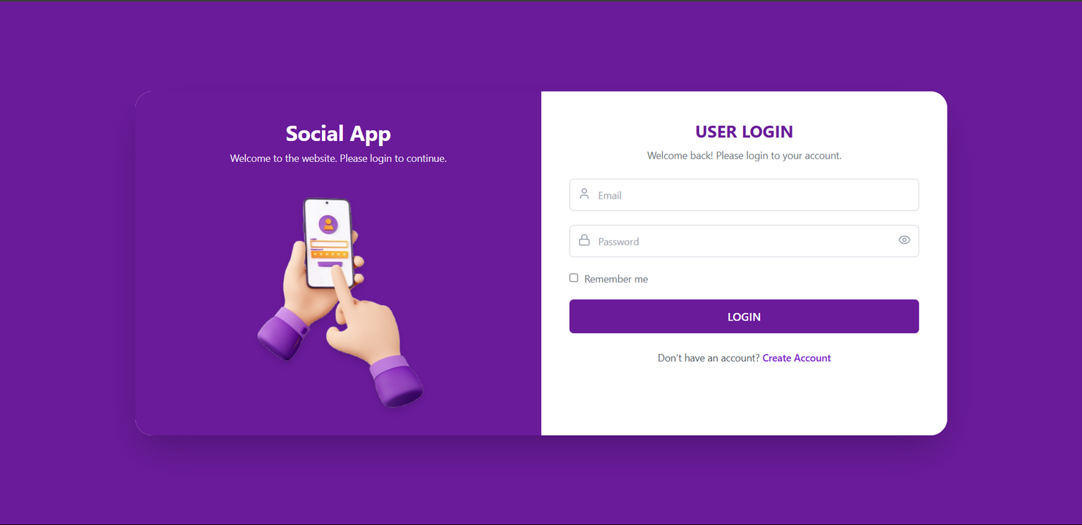
Secure Registration and Login with JWT
Login
Welcome back! Please login to your account.

Slide 7
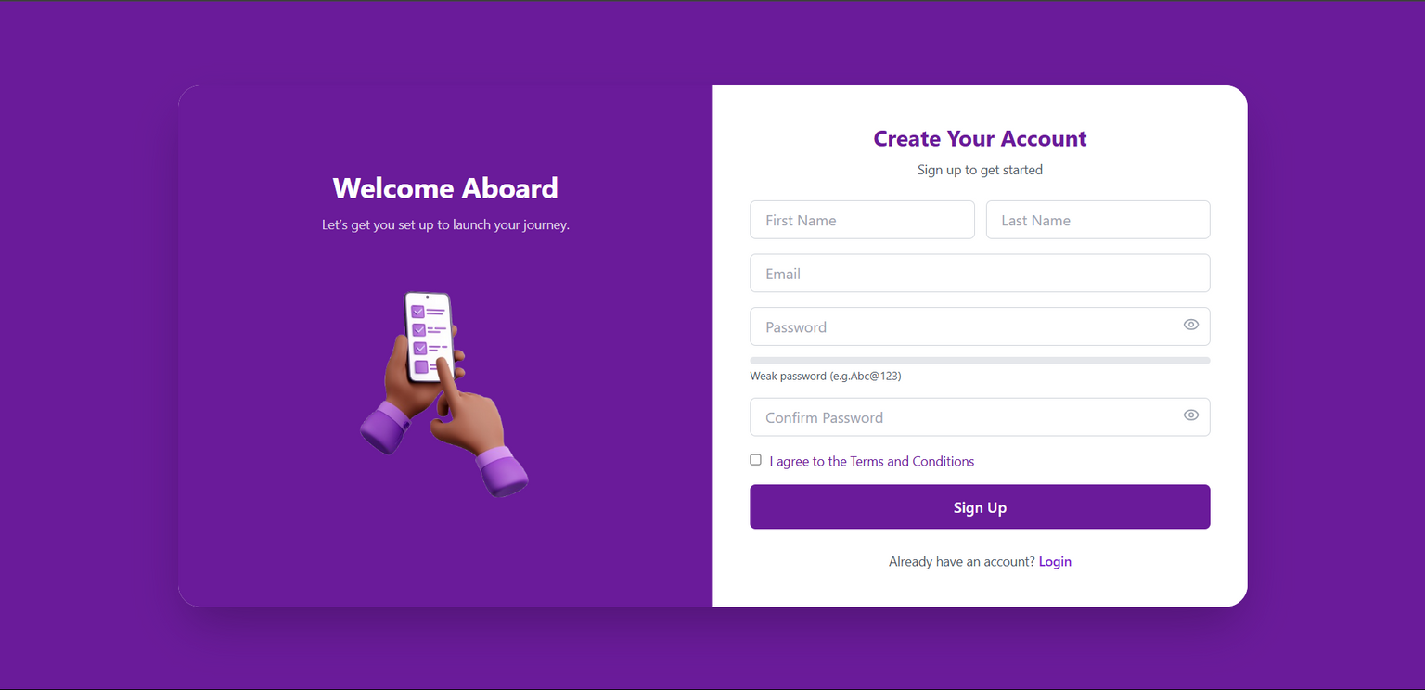
Secure Registration and Login with JWT
Login
Welcome back! Please login to your account.

Slide 8
Express & Share (Posts)
1
Create posts with text, images, or videos
2
View your posts and others’ content
Like, unlike, and delete your posts
3

Slide 9
Comments & Engagement
1
Comment and like/unlike posts
2
Track interaction with like/comment counts

Slide 10
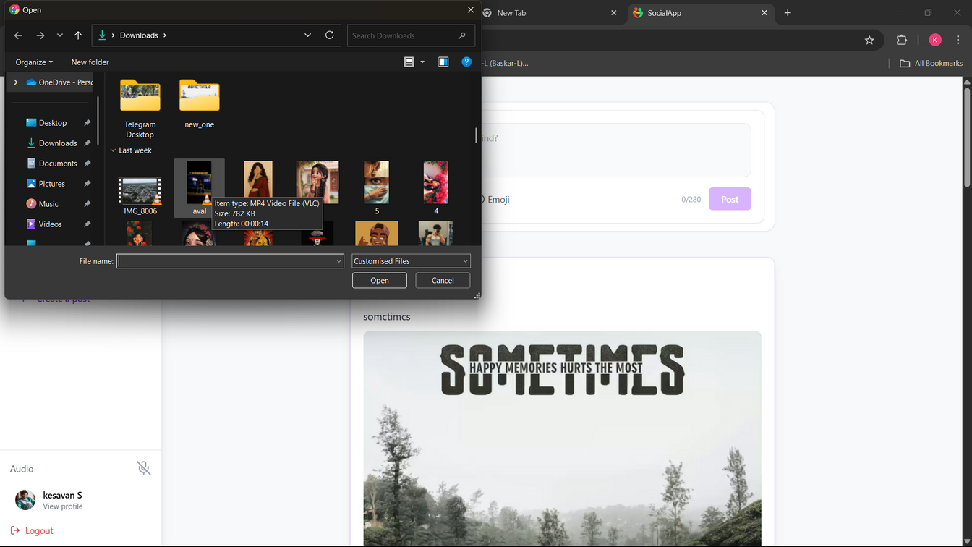
posts & like/unlike conmment

Slide 11
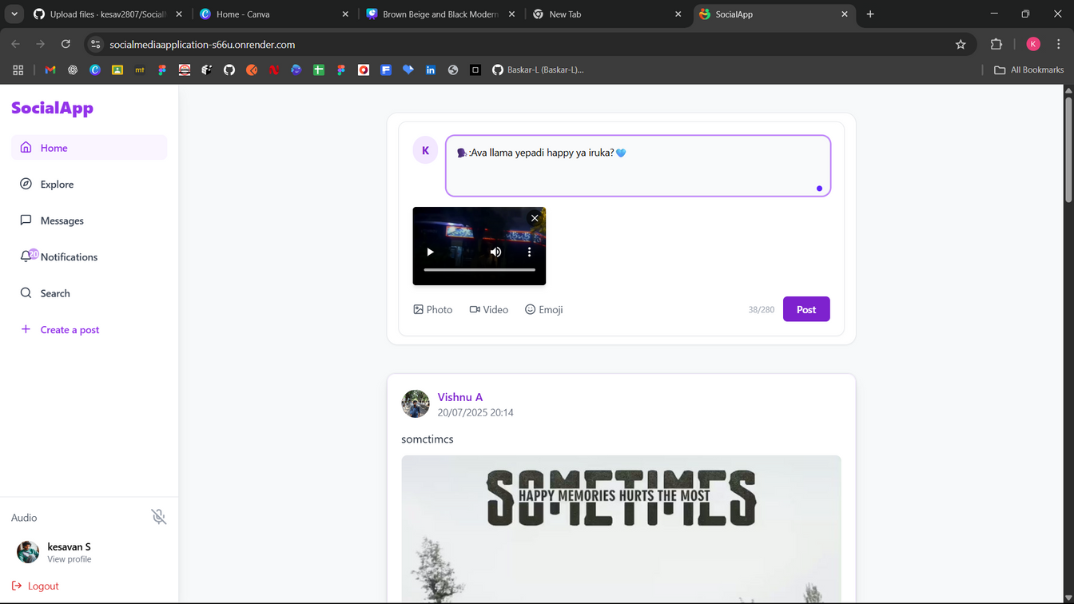
posts & like/unlike conmment

Slide 12
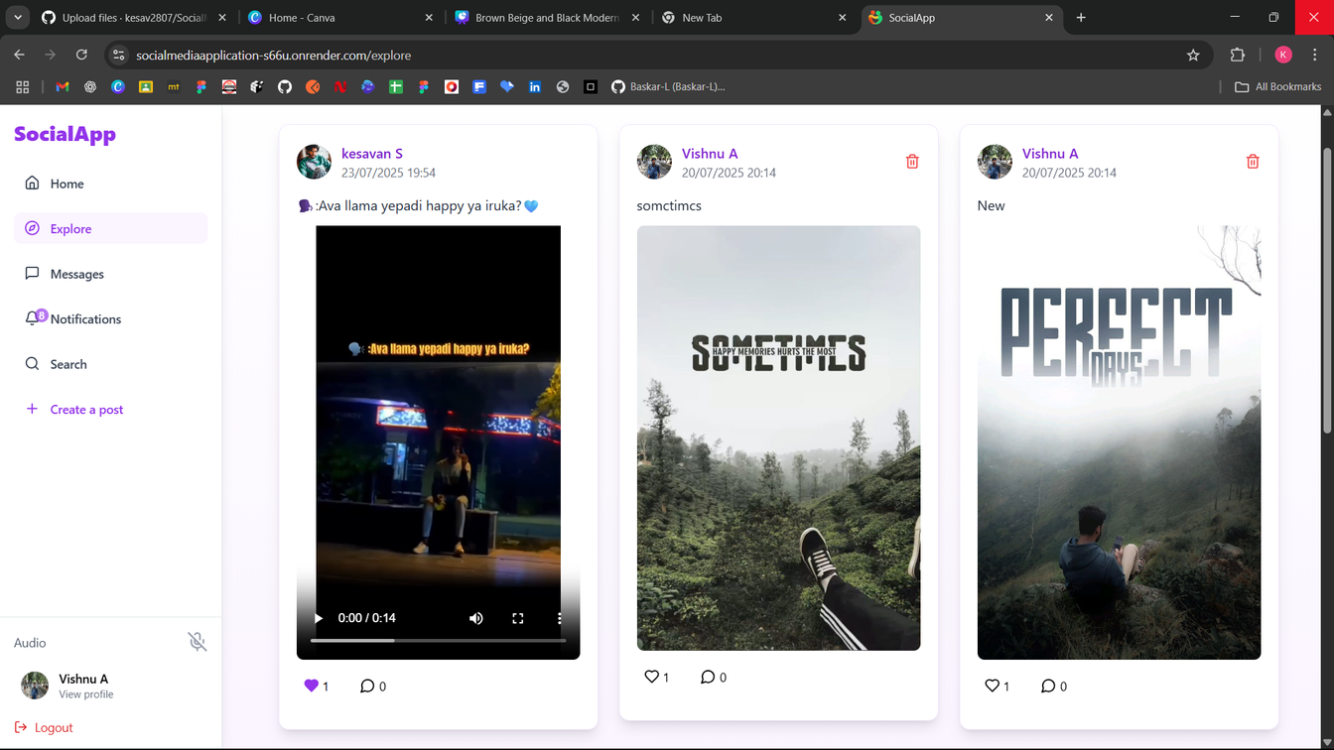
posts & like/unlike conmment

Slide 13
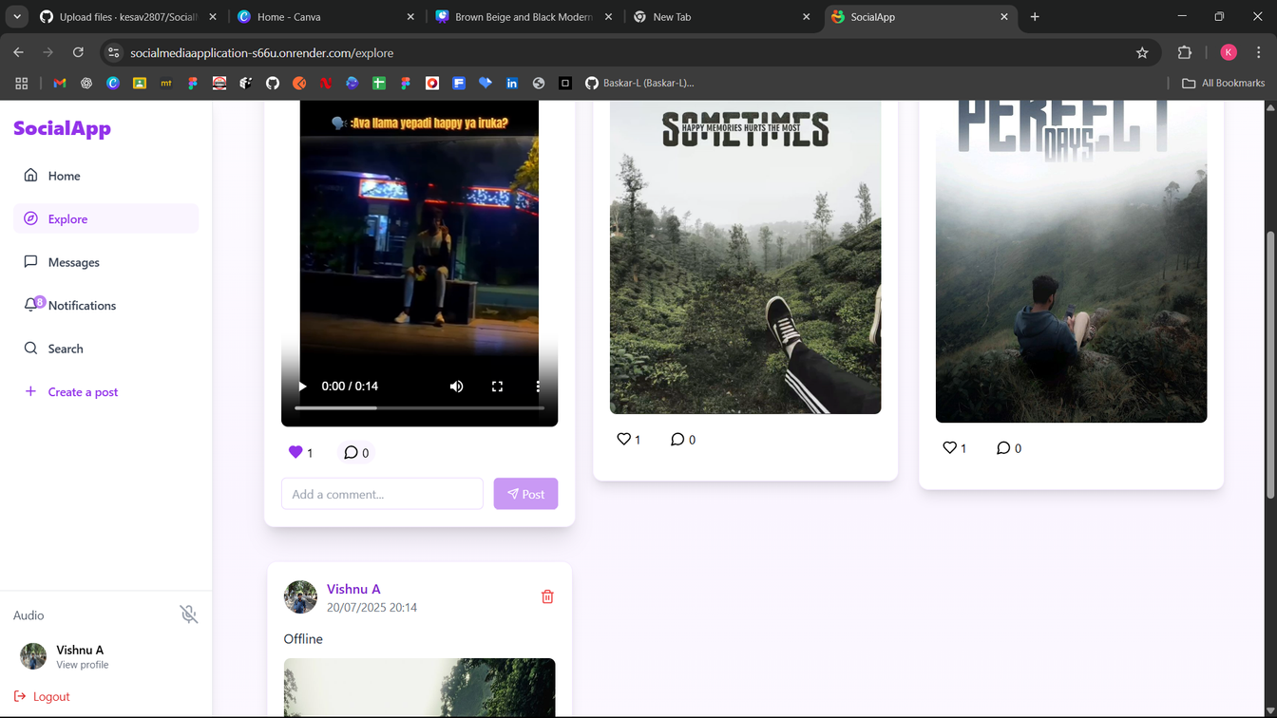
posts & like/unlike conmment

Slide 14
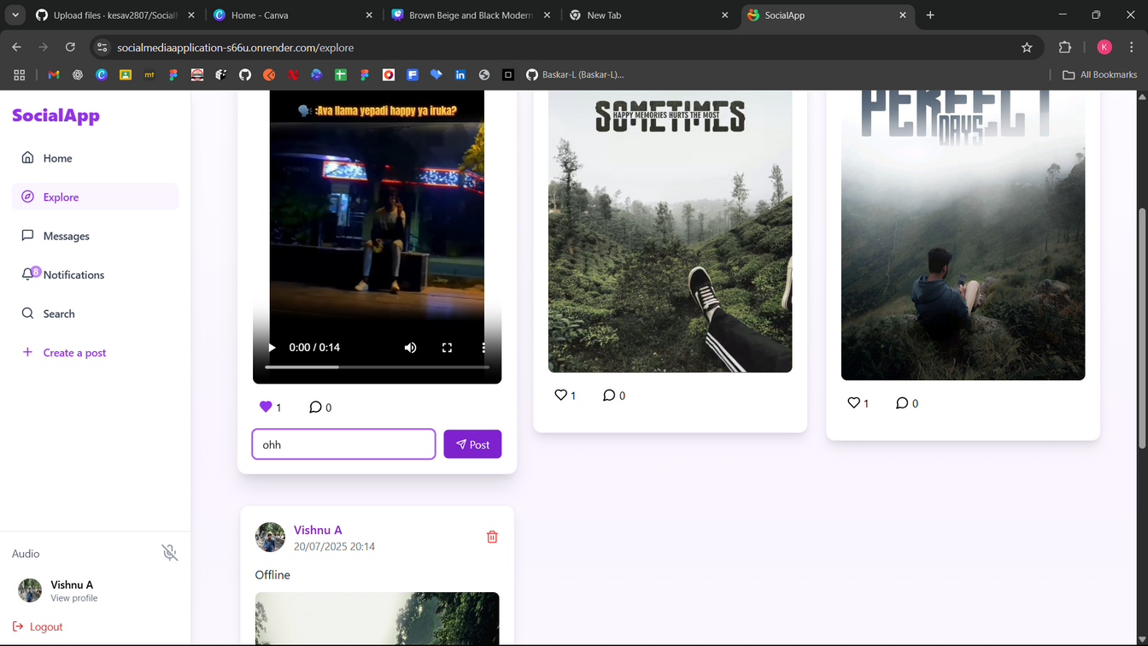
posts & like/unlike conmment

Slide 15
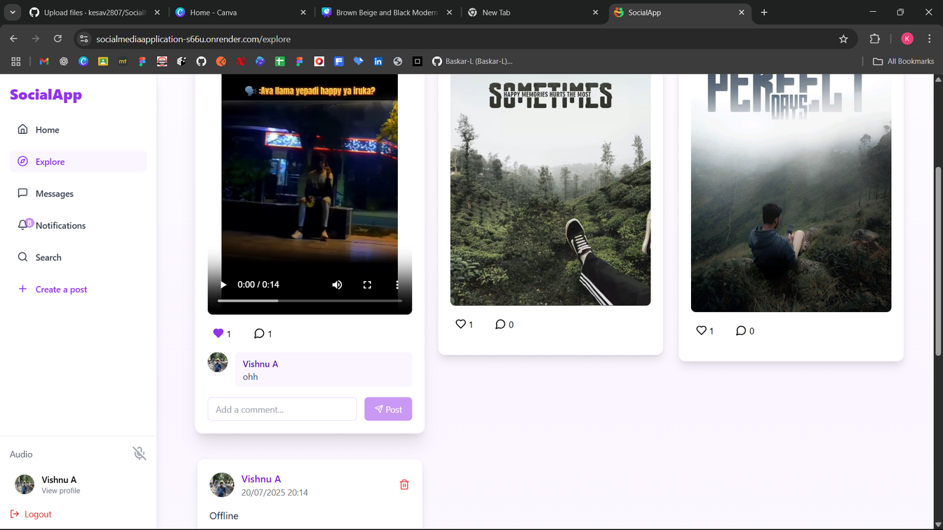
posts & like/unlike conmment

Slide 16
Build Your Community
1
Follow/unfollow users
2
Live follower/following counts
3
Feed shows posts from followed users

Slide 17
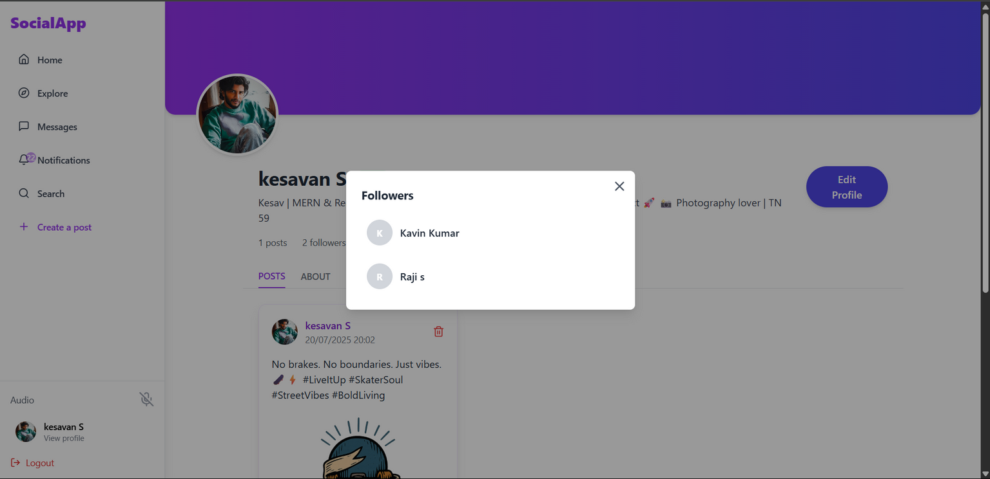
Live follower/following counts

Slide 18
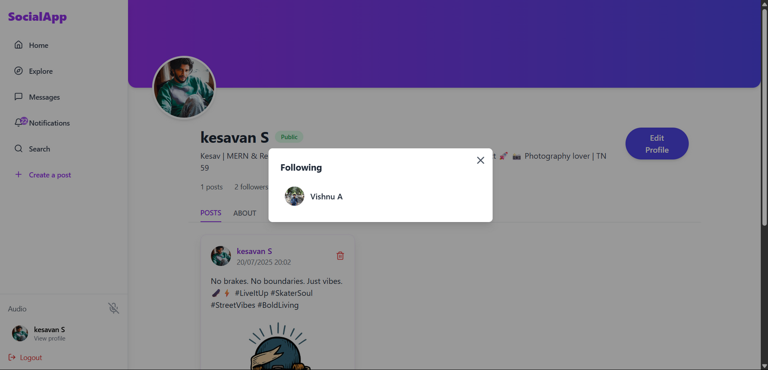
Live follower/following counts

Slide 19
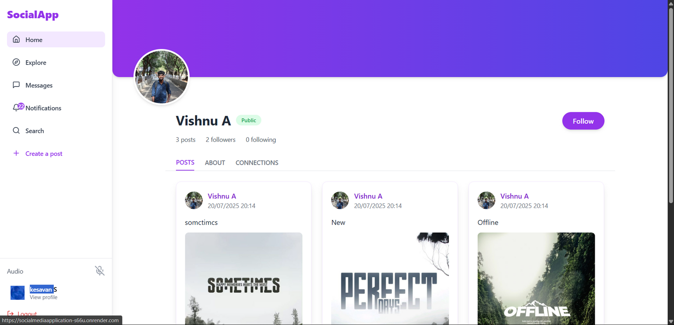

Slide 21
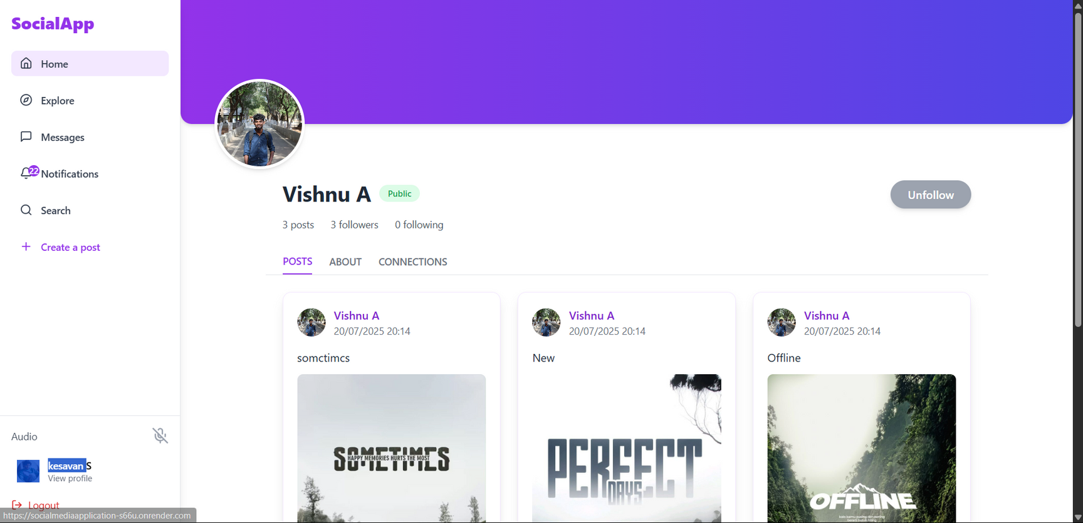

Slide 22
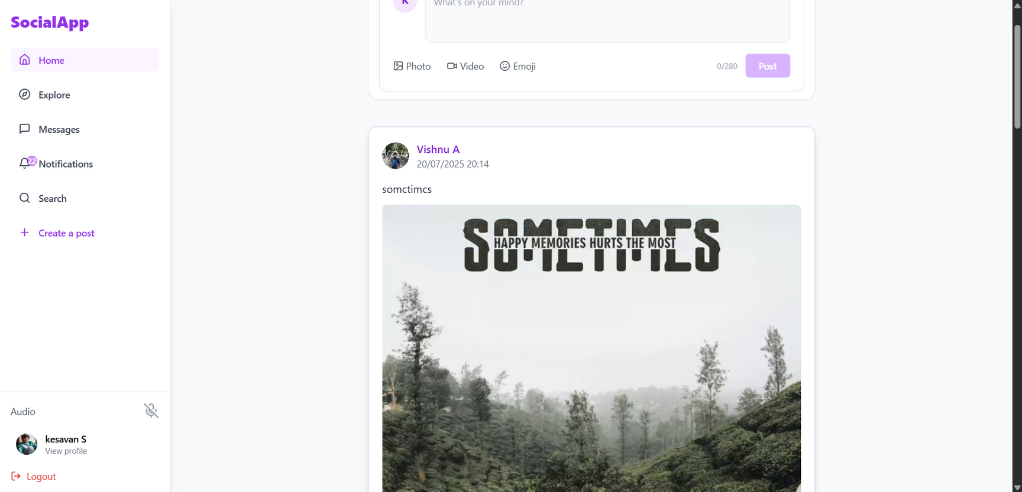
Use Home Page

Slide 23
Feed & Explore Modes
1
Feed: personalized from followed users
2
Explore: discover trending or random content

Slide 24
Use Home Page Followed Users

Slide 25
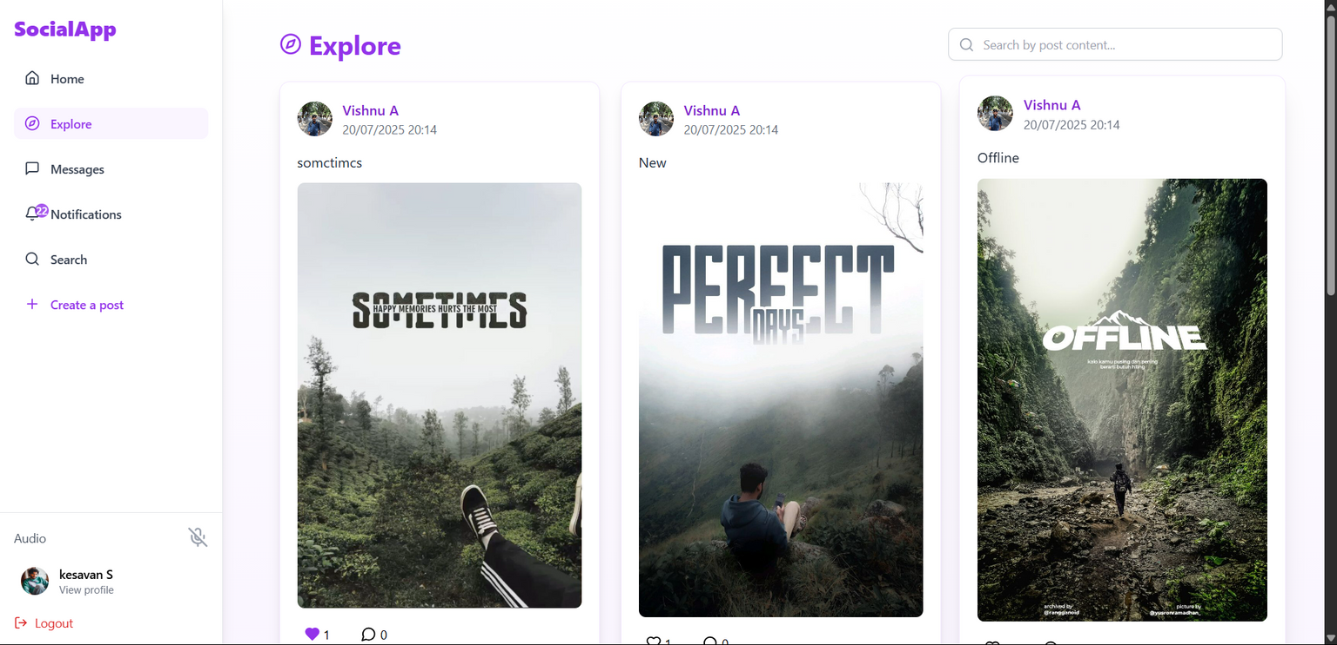
Ecplore In Following User & Public User

Slide 26
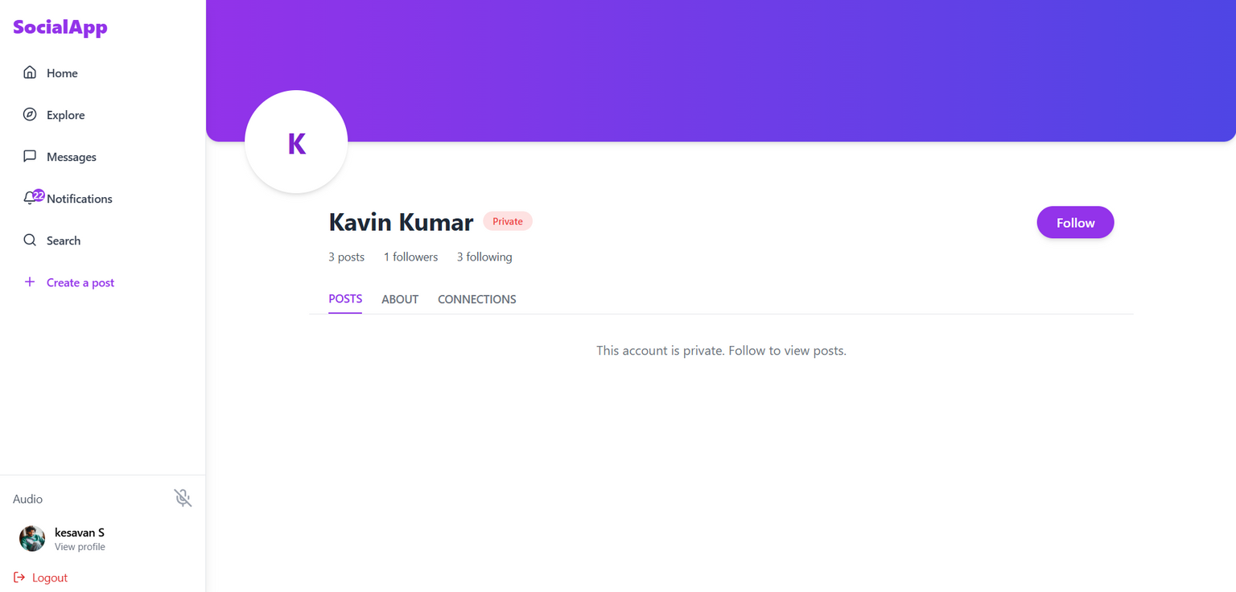
PrivateUser

Slide 27
Content Ownership & Security
1
Only creators can edit/delete their content
2
Strict backend authorization in place

Slide 28
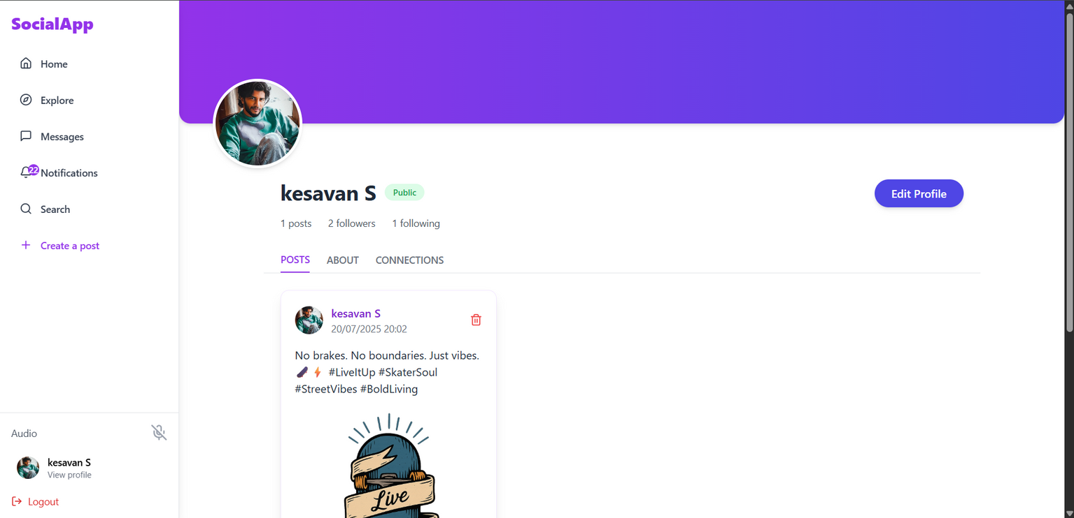
Edit Profile

Slide 29
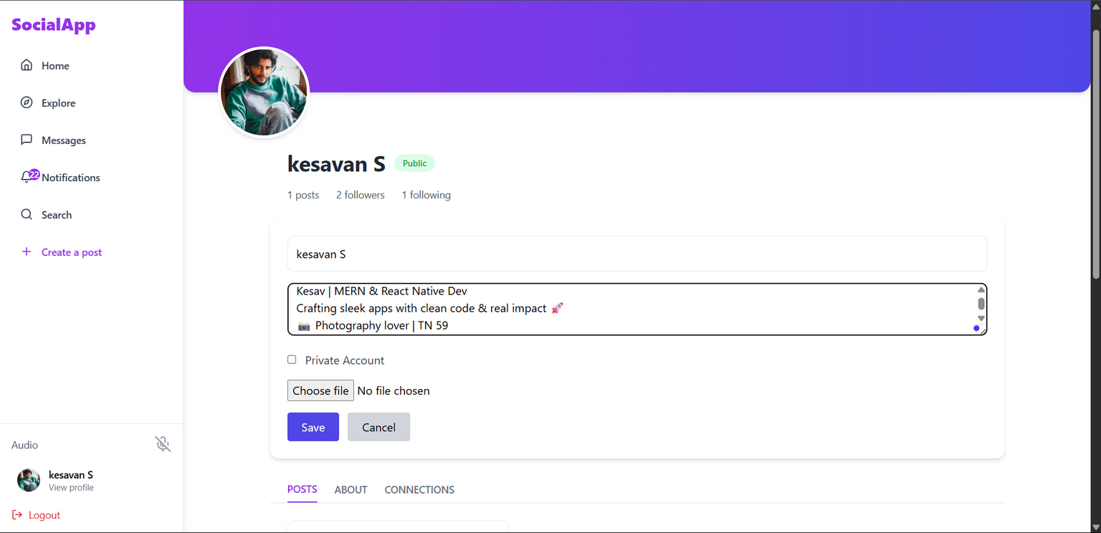
Edit Profile

Slide 30
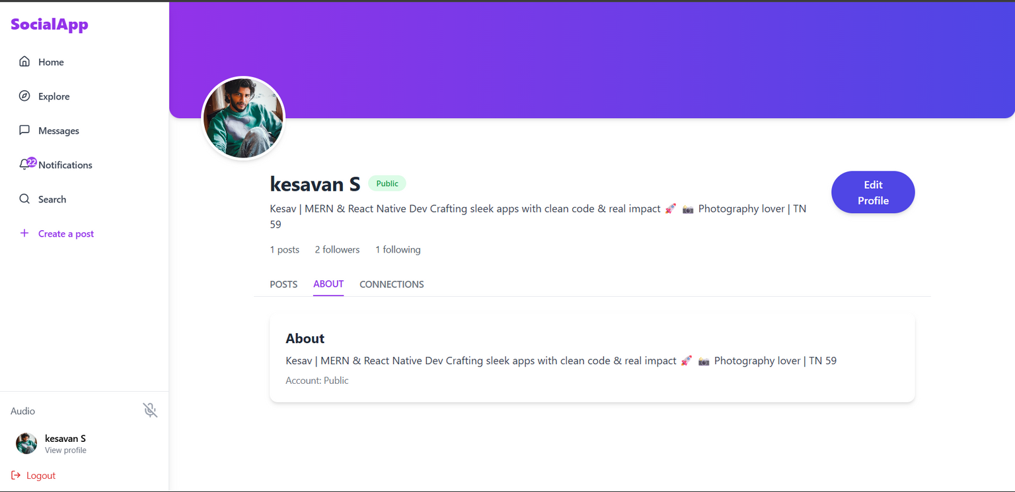
Edit Profile

Slide 31
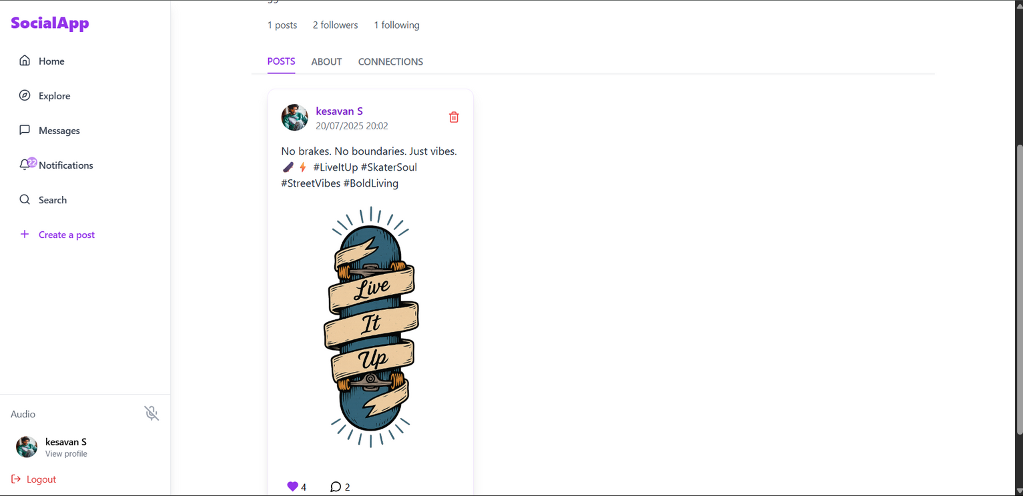
Delete a Post

Slide 32
Real-Time Messaging
1
1-on-1 private chat with status indicators
2
Typing indicator, online/offline presence
3
Group chats with roles and mentions

Slide 33
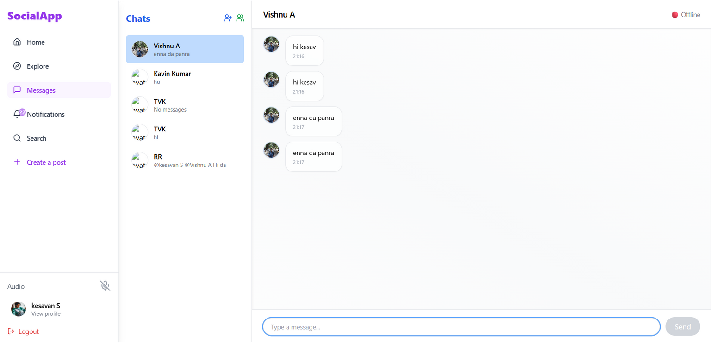
1-on-1 private chat with status indicators

Slide 34
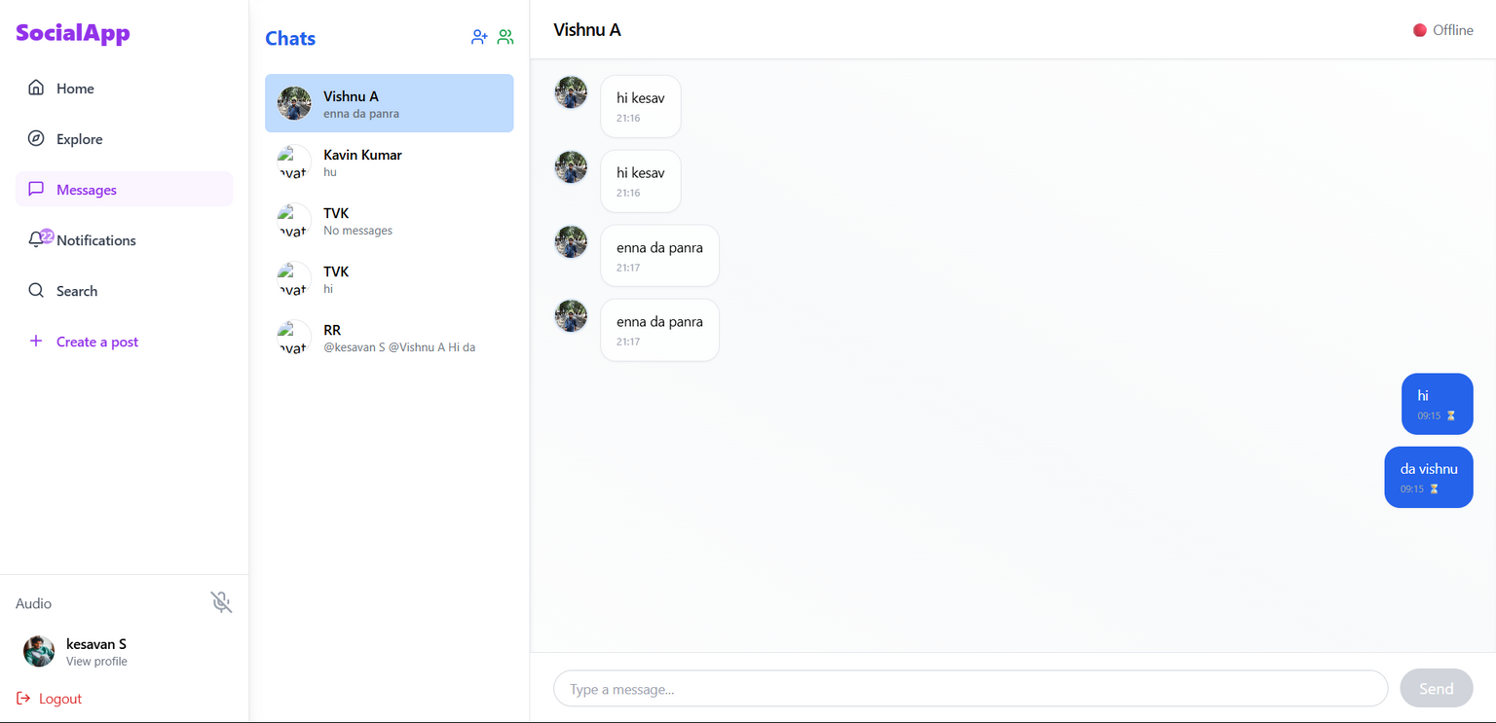
1-on-1 private chat with status indicators

Slide 35
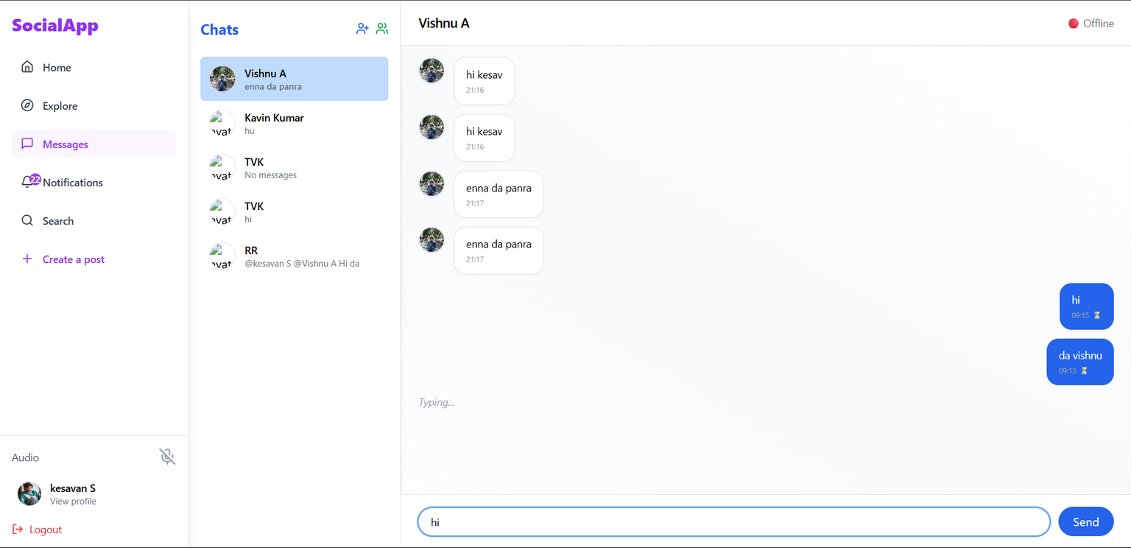
Typing indicator, online/offline presence

Slide 36
Typing indicator, online/offline presence

Slide 37
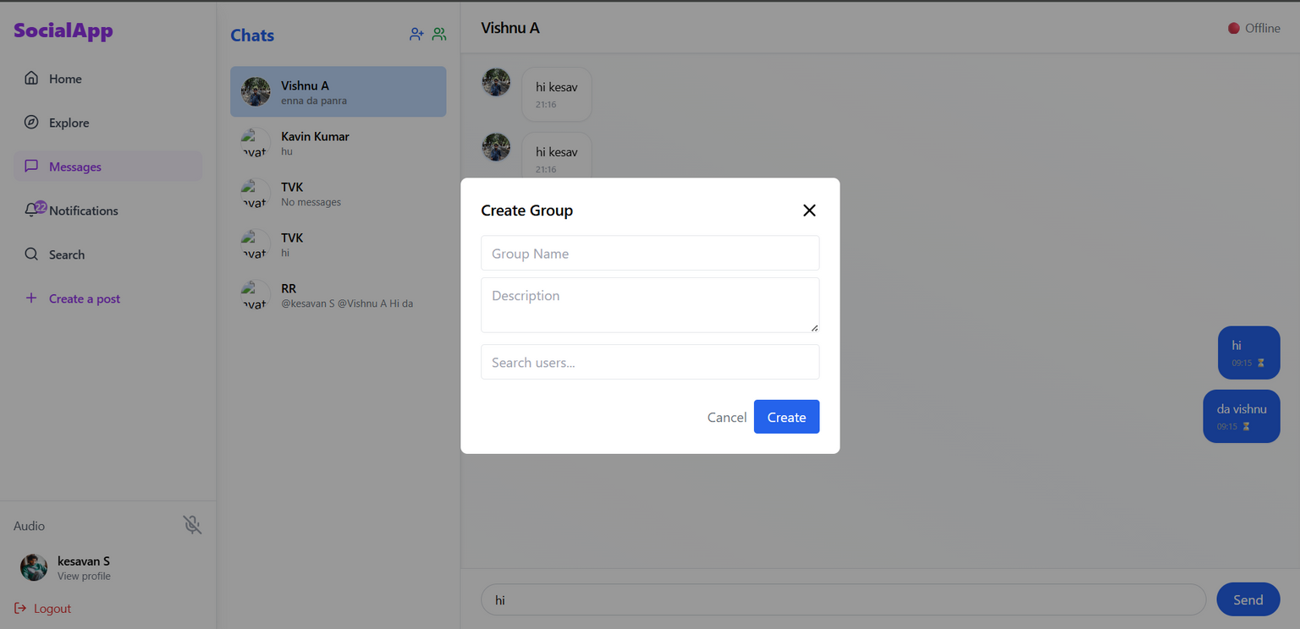
Group chats with roles and mentions

Slide 38
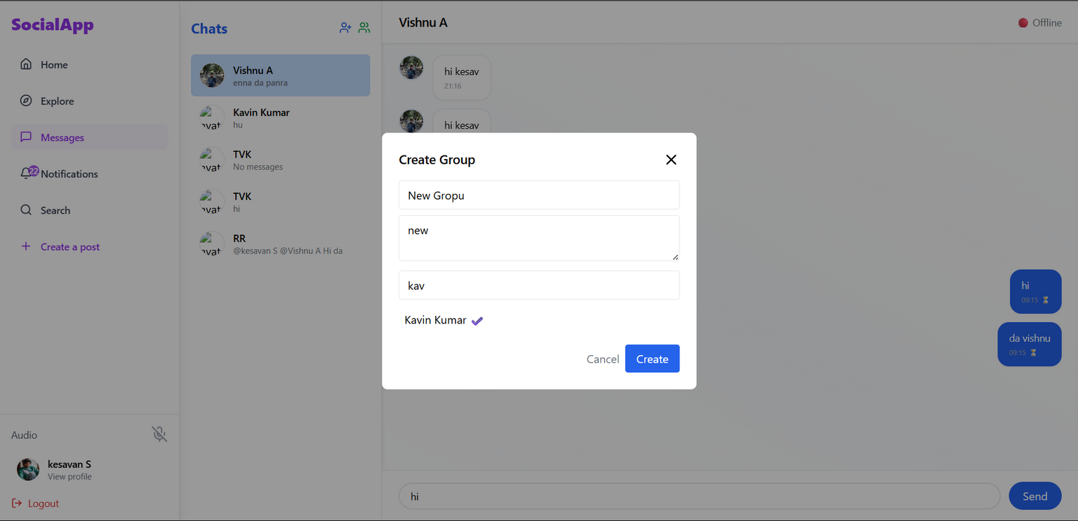
Group chats with roles and mentions

Slide 39
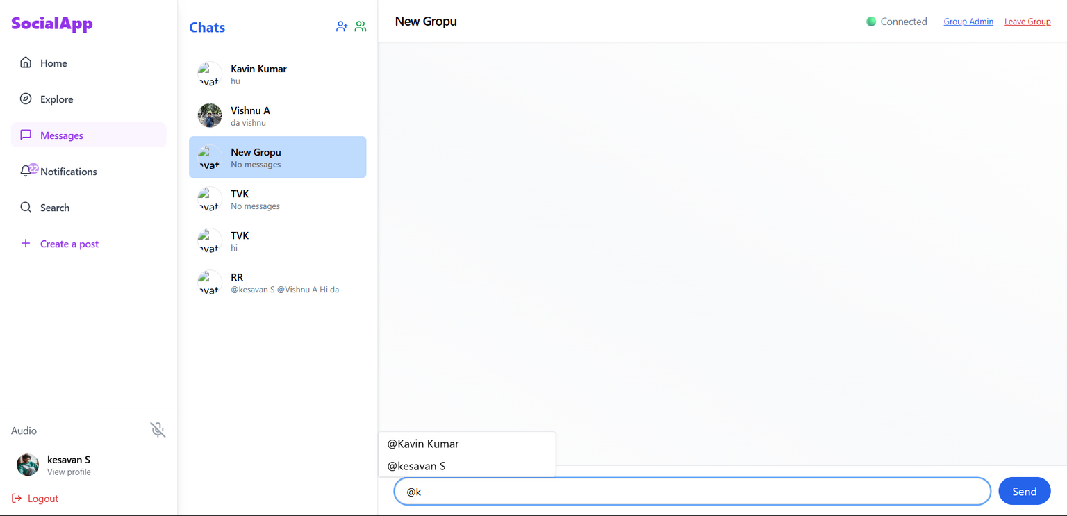
Group chats with roles and mentions

Slide 40
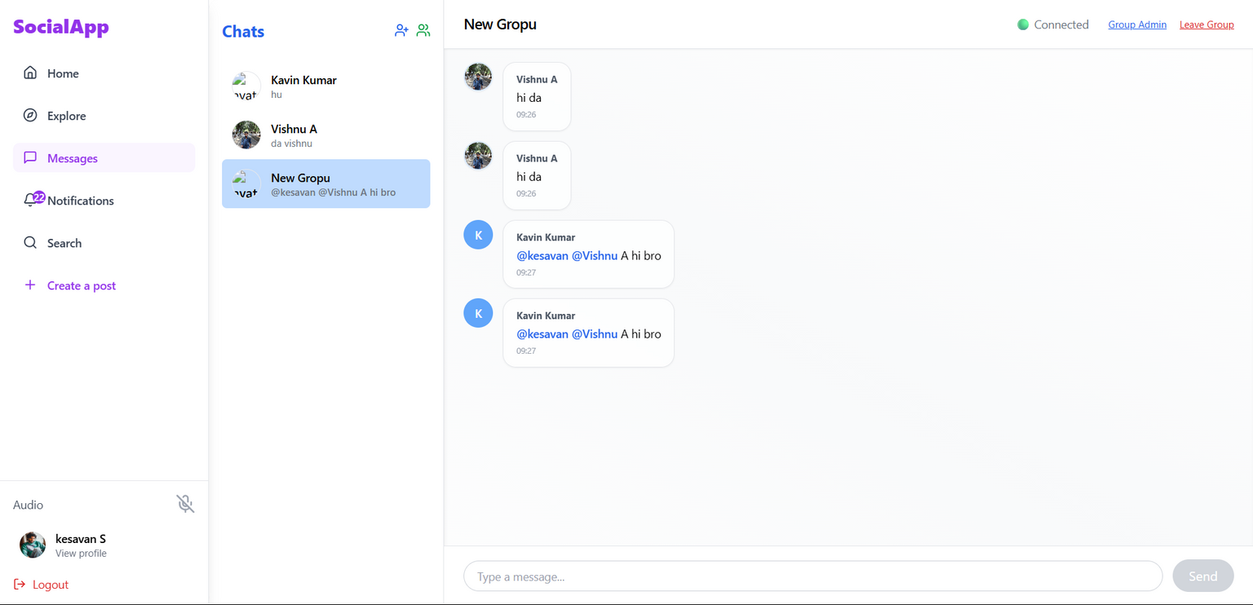
Group chats with roles and mentions

Slide 41
Group chats with roles and mentions

Slide 42
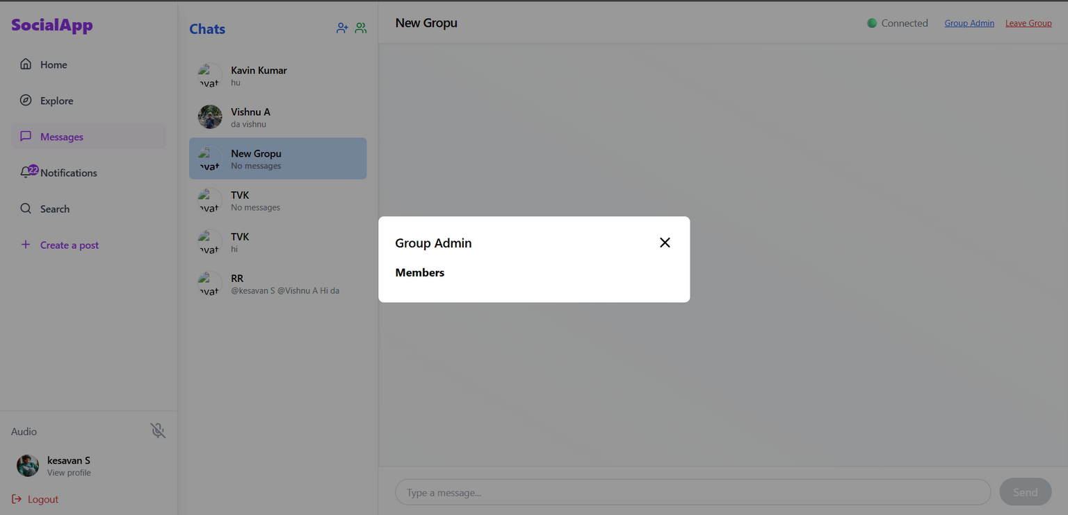
Group chats with roles and mentions

Slide 43
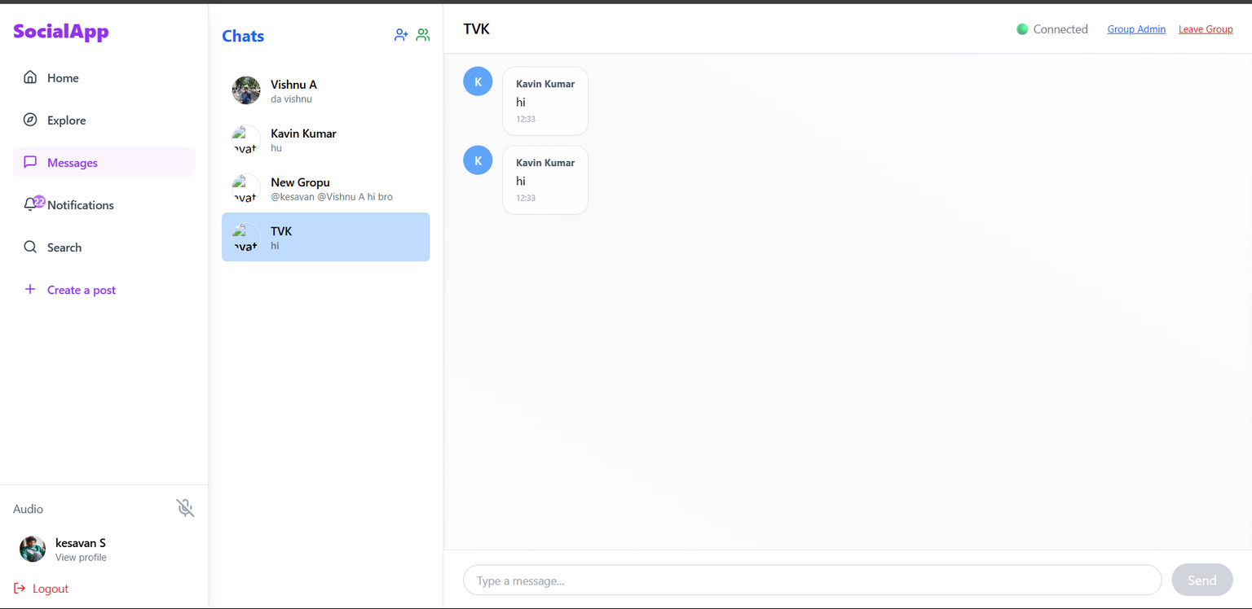
Group chats with roles and mentions

Slide 44
Smart Notifications
1
Real-time alerts: messages, mentions, likes, comments, follows
2
Keeps users informed without clutter

Slide 45
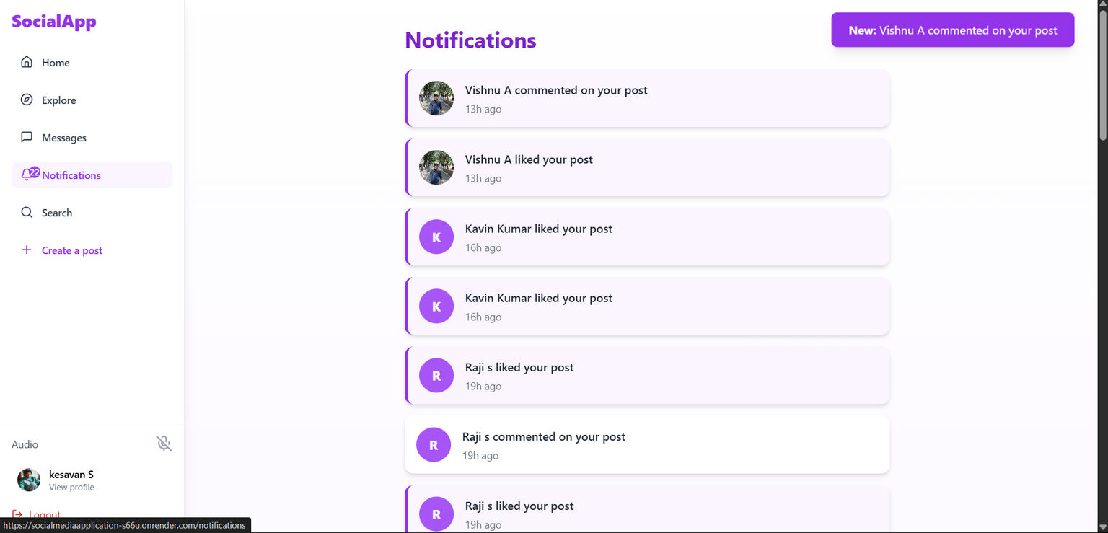
Smart Notifications

Slide 46
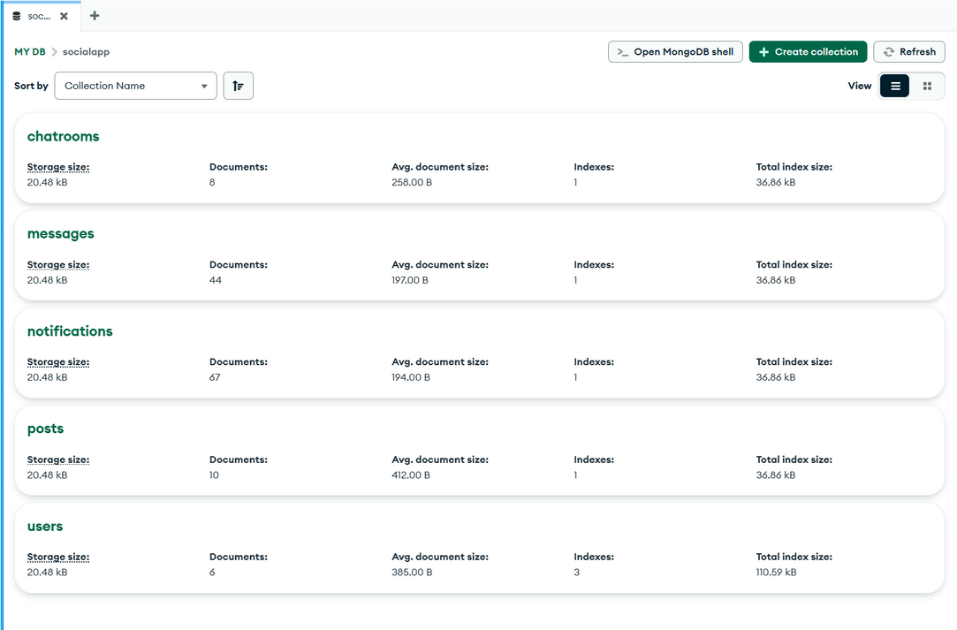
database

Slide 47
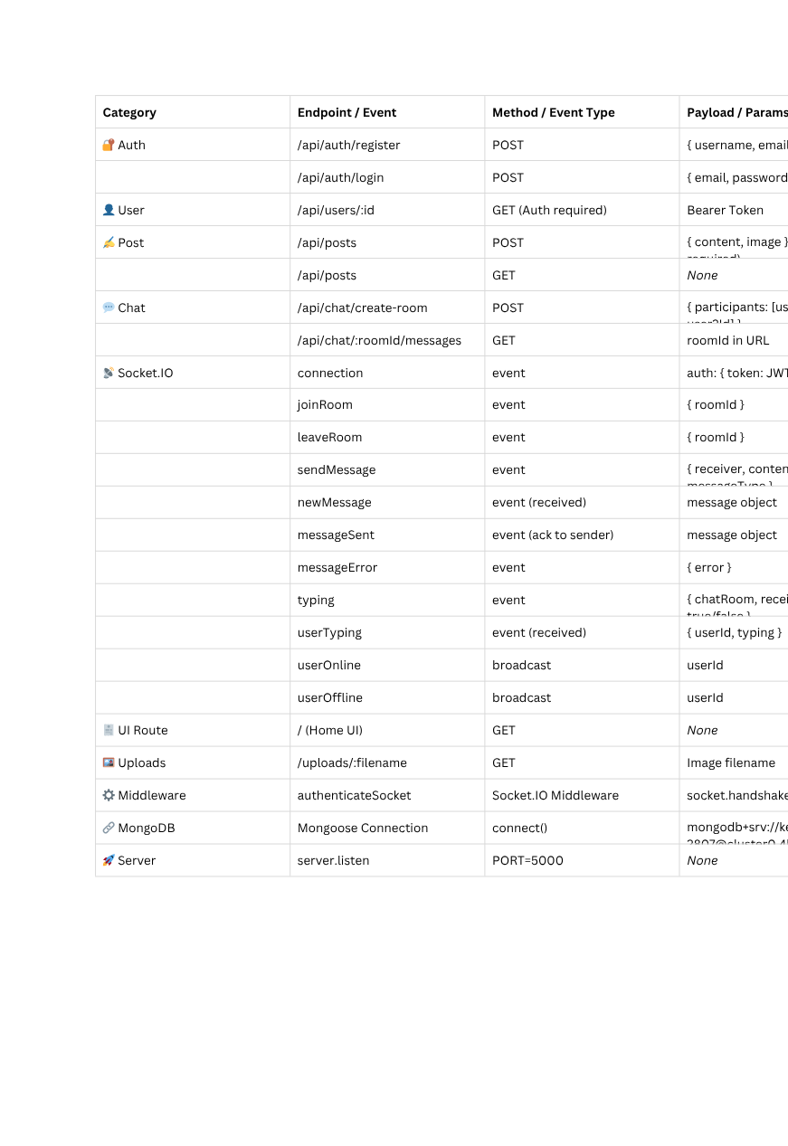
testing table

Slide 48

Conclusion
SocialApp is the culmination of thoughtful design, robust engineering, and a user-first approach. Built on the MERN stack, it provides a powerful backend foundation and an engaging frontend experience. Every feature—from real-time chat and notifications to profile customization and content sharing—has been crafted to empower users and foster meaningful connections.
Despite challenges in both frontend and backend development, the project demonstrates scalability, security, and modern design principles. SocialApp is not just a social media platform; it’s a digital space where people can truly engage, express, and grow—reliably and seamlessly.

Slide 49
Thank You
Presented by:
Kesavan S
Spangles Infotech | 2025

